Slide 1
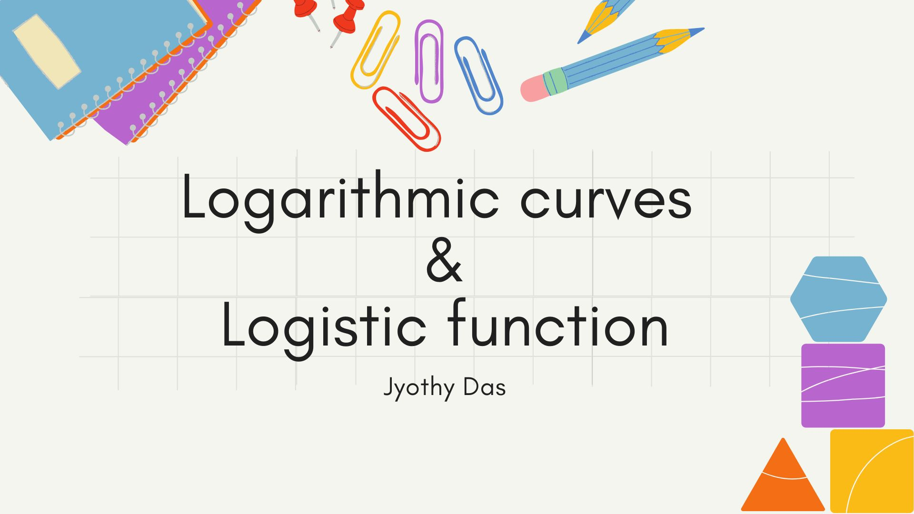

Slide 2
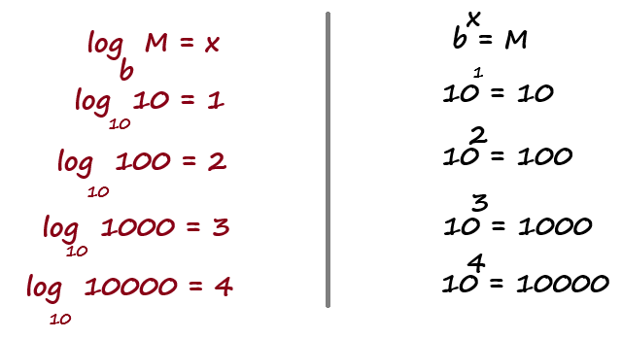
Logarithmic function
A logarithm is the exponent to which a base must be raised to produce a given number.

Slide 3
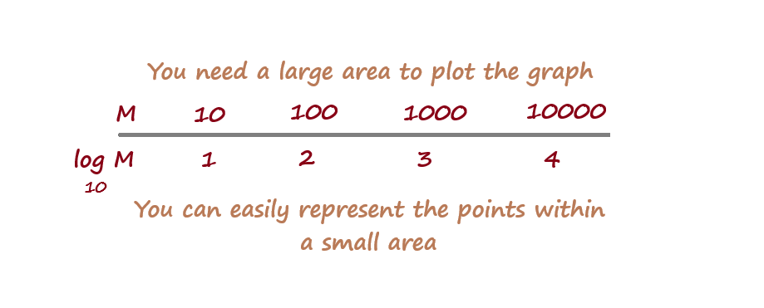
Logarithmic function

Slide 4
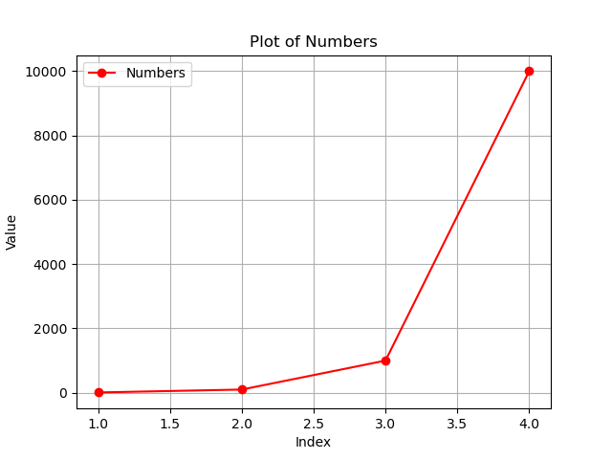
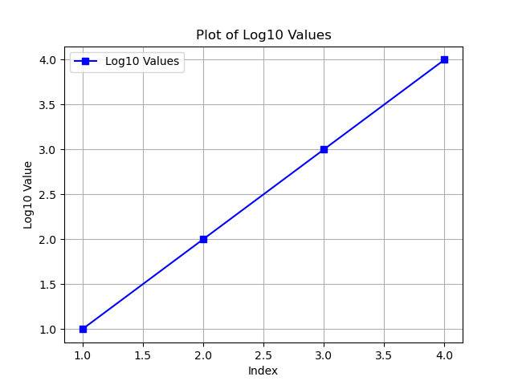
Logarithmic function

Slide 5
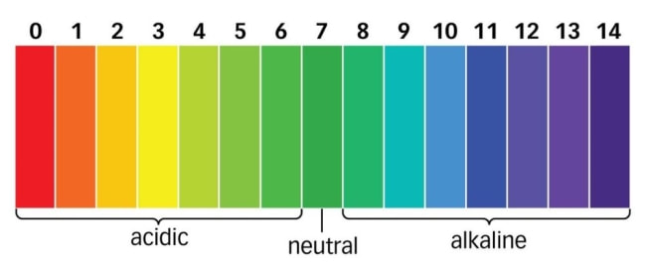
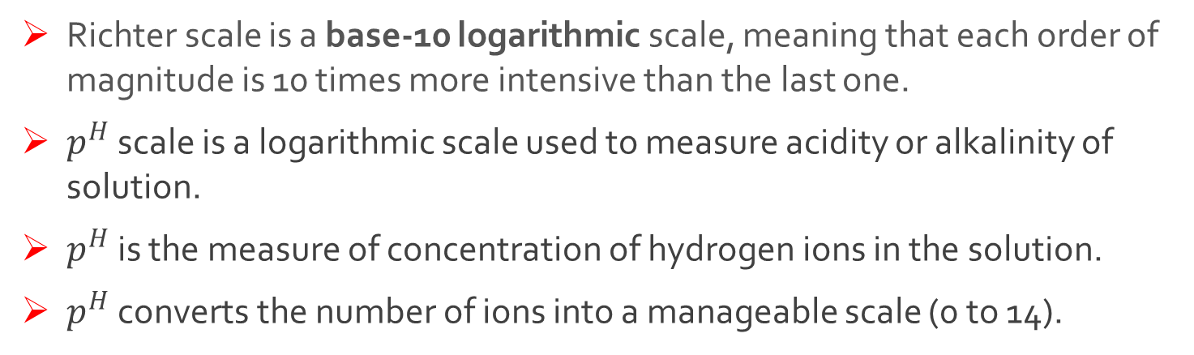
Logarithmic function
Richter scale is a base-10 logarithmic scale, meaning that each order of magnitude is 10 times more intensive than the last one.
$p^{H}$ scale is a logarithmic scale used to measure acidity or alkalinity of solution.
$p^{H}$ is the measure of concentration of hydrogen ions in the solution.
$p^{H}$ converts the number of ions into a manageable scale (0 to 14).

Slide 6
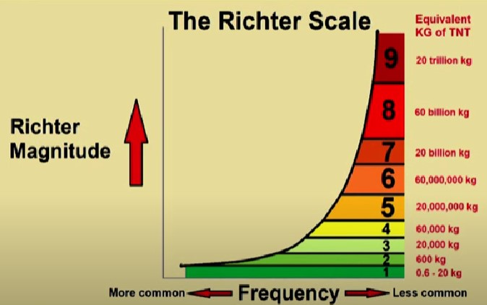
Logarithmic function

Slide 7
Logarithmic Curves and Tower Pressure
Logarithmic curve's shape is derived from the mathematical relationship between pressure and the height of a column of material.
As the height increases, the pressure also increases, but the logarithmic curve offsets this increase by reducing the cross-sectional area proportionally.

Slide 8
Logarithmic curve: Real-world applications
While not as common as other structural shapes, logarithmic curves have been used in the design of certain structures, such as:
Chimneys: The tapering shape of some chimneys can be approximated by a logarithmic curve, helping to distribute the weight of the brickwork and resist wind loads.
Retaining Walls: Logarithmic curves can be used to design retaining walls that can withstand the lateral pressure of soil.
Specialized Structures: In some cases, architects and engineers may employ logarithmic curves for aesthetic or functional reasons in unique structures.

Slide 9
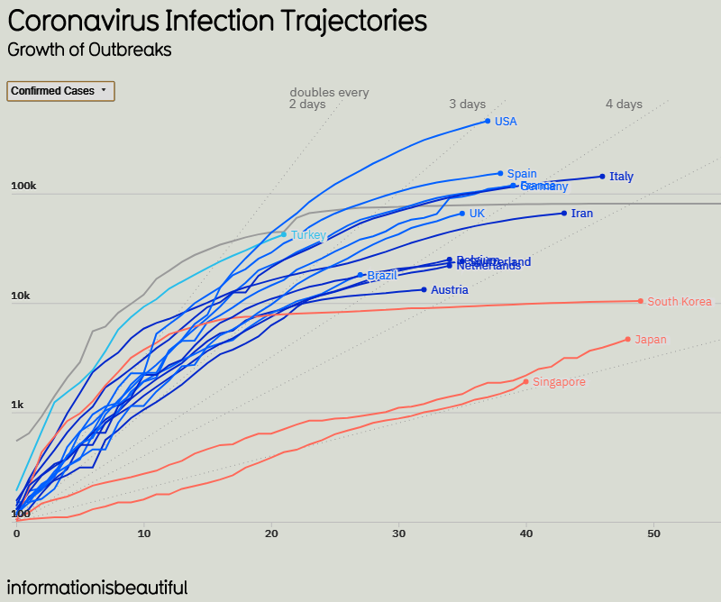
Logarithmic curve: Real-world applications

Slide 10
Logarithmic curve: Real-world applications
Learning a new skill:
The Steep Start: In the beginning, you'll improve quickly.
The Slow and Steady Climb: As you get better, it gets harder to improve. You might need to practice for a long time to get a little faster or learn a new trick.
Habits (Eg: Exercising)
Initial Motivation: Initially you might feel highly motivated and experience significant progress.
Maintaining Consistency: As time goes on, maintaining the habit can become more challenging.

Slide 11
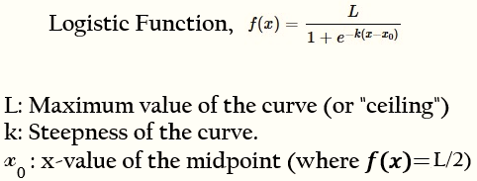
Logistic function
Note : Higher ‘k’ means steeper curve

Slide 12
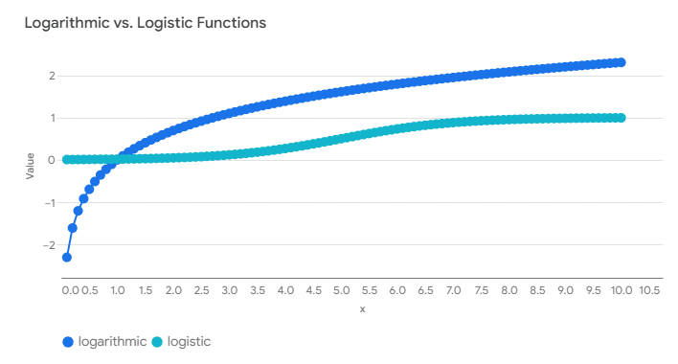
Logarithmic function Vs Logistic function
The logarithmic curve exhibits a gradual increase that slows down as x increases.
Logistic function displays an S-shaped curve with an initial slow increase, followed by a rapid rise, and eventually levels off.

Slide 13
Logarithmic function Vs Logistic function
Key Differences:
Shape: A logarithmic curve continues to increase slowly, while a logistic curve eventually levels off.
Growth Rate: In a logarithmic curve, the growth rate continuously decreases. In a logistic curve, the growth rate increases initially, reaches a maximum, and then decreases.
Limits: A logarithmic curve has no upper limit, while a logistic curve has a defined upper limit.

Slide 14

Sigmoid Function
Special case of logistic function where:
L = 1 (maximum value of the curve is 1)
K = 1 (steepness is fixed)
X0 ​= 0 (midpoint is at 0)

Slide 15
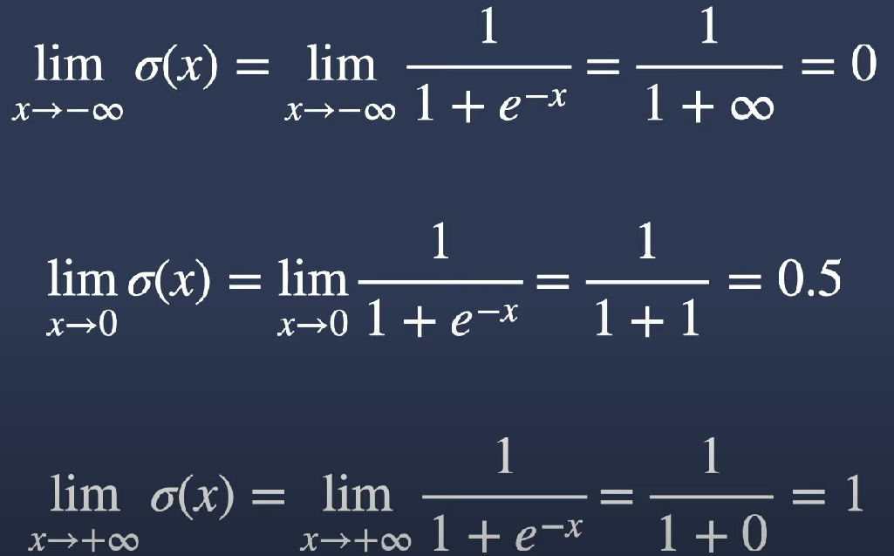
Limits of the sigmoid function

Slide 16
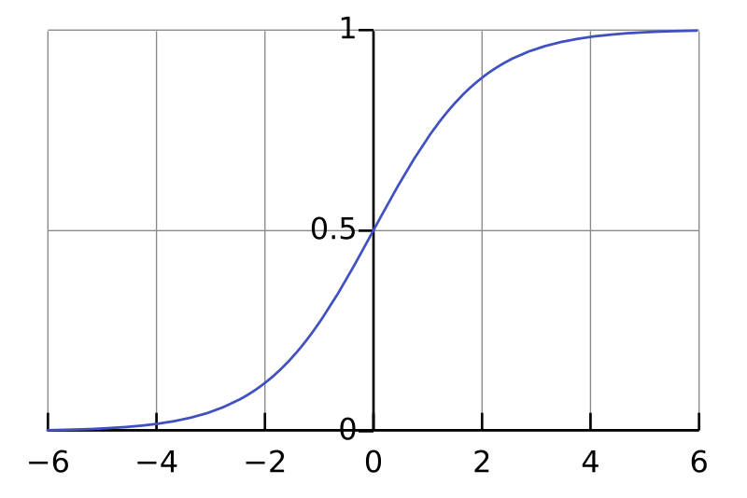
Sigmoid function
The value of sigmoid function ranges between 0 and 1.
It never reaches a maximum.
The sigmoid is nearly 0 when x is large negative, and is nearly 1 when x is large positive. In our applications, x is a linear combinations of predictors.

Slide 17
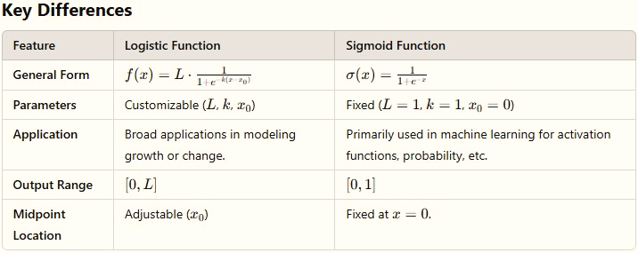
Logistic function Vs Sigmoid Function

Slide 18
Conclusion
Although a small portion of a logistic curve on the positive x-axis might resemble a logarithmic curve, they are fundamentally different functions with distinct characteristics and applications.
Sigmoid function is a special case of logistic function.

Slide 19
References
https://informationisbeautiful.net/visualizations/covid-19-coronavirus-infographic-datapack/

